Slide 1
Best Practices for Fostering Safe International Collaborations
Kimberly Eck, MPH, PhD
Associate Vice President for Research
Notes:
Thank you for giving me the opportunity to speak to you. To continue Emory’s legacy of international collaboration and academic freedom we all need safeguard research and Know our Collaborators. In the next few minutes I want to share with you the scope of the problem and some tips for fostering safe international collaborations.

Slide 2
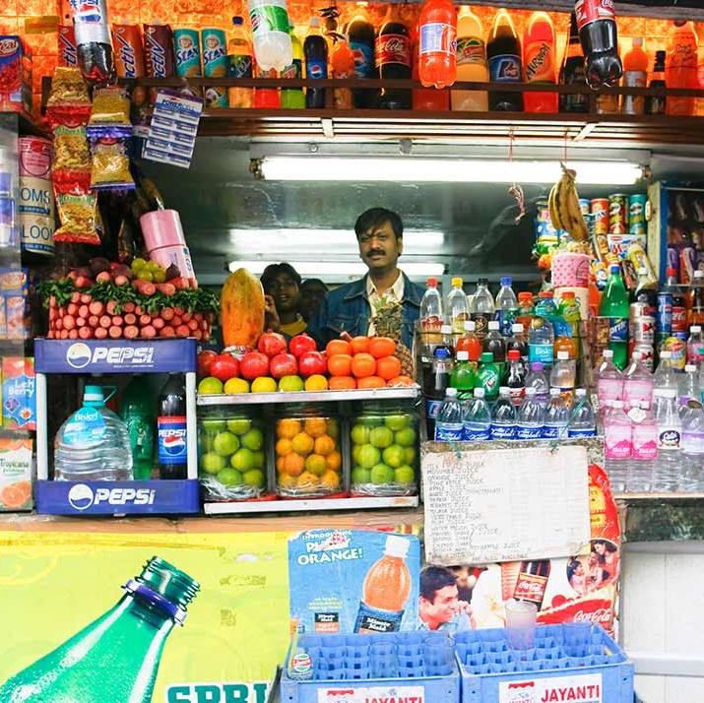
Emory’s International Footprint
Halle Institute for Global Research
Global Diabetes Research Center
Emory’s Ethiopia Office
Notes:
International collaborations are foundational to Emory’s research profile. It’s a part of how we work and teach. Everyone in the SVPR offices, ORA, and other administrative offices want to help faculty do more international research! But international research is complicated. So, I’m going out and talking to faculty to share information, offer some tips, and invite you to seek tailored guidance so that you can collaborate with confidence.

Slide 3
Research Security
Since 2018
87 | universities contacted by the NIH regarding research integrity
189 | U.S. scientists sanctioned
77 | researchers blocked from applying from new NIH grants
54 | researchers terminated from their roles
Foreign actors seek to unfairly benefit from U.S. advances in science and technology
The impact to national security and the U.S. economic system is real and growing
Source: AAAS, July 14, 2020
Notes:
As one of the nation’s leading research institutions, Emory is a potential target for foreign actors. We’ve stepped up efforts to identify and better understand the relationships our researchers receiving federal funding may have with foreign organizations, including governments, corporations, or universities. And with good reason. (Read/call out highlights from last box) Additionally, the NSF has cancelled approximately 20 grants and recovered $4.6M in funding from researchers who were compromised.

Slide 4
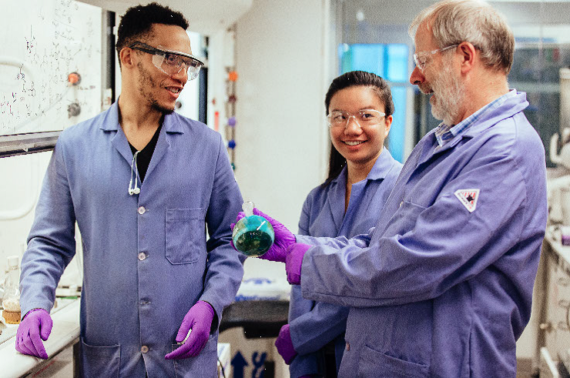
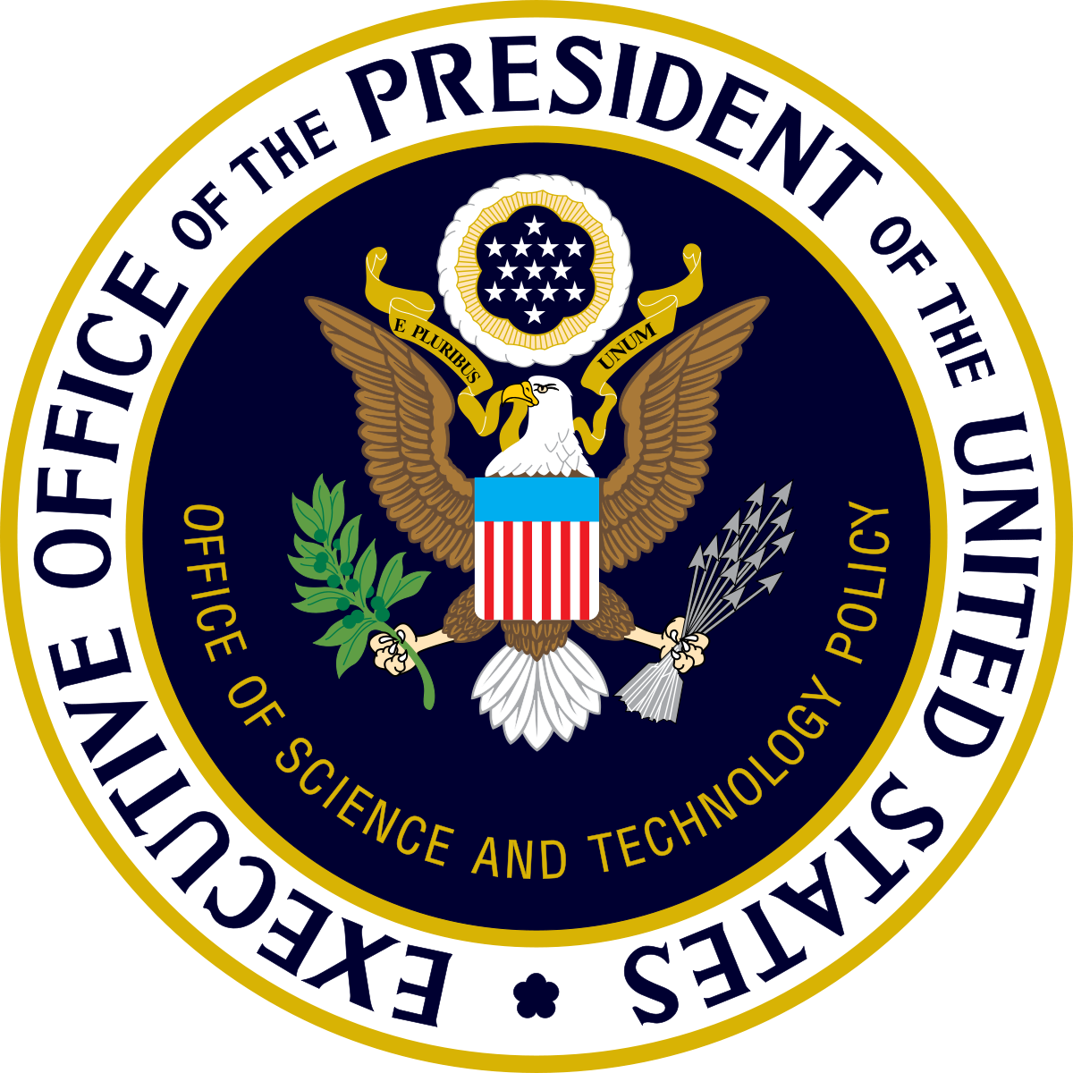
Why Academia?
Centers for innovation and discovery
Responsible for (NCSES):
50% of all U.S. basic research
10%-15% of total U.S. R&D
Culture of openness and collaboration
Legacy of international collaboration
Notes:
As a leader in research on biotech, medicine, brain science, and advanced pharma, Emory is a target for foreign actors. The FBI, CIA, DHS, the White House Office of Science and Technology Policy, and federal funding agencies have asked academia to help protect U.S. science and technology innovation.

Slide 5
Targeted areas most relevant to Emory
BIG DATA
Precision medicine & health data
Biotech & medical services
Advanced pharmaceuticals & VACCINES
BRAIN SCIENCE
ENERGY EFFICIENT Technologies
Notes:
There’s a pattern to the types of innovation and discovery that are being targeted. This includes the internet of things (quantum communications, computing, cyber security, smart-grid technology), health and biomedical technologies, new resources and frontiers (space and sea exploration, seed-industry innovation, transportation and advances in energy and power generation). Here I’ve highlighted some of the targeted areas that are most aligned with Emory’s research profile.

Slide 6
Non-traditional tactics now used to access research
Project collaboration invitations
Prospective students or trainees
Talent programs & innovation competitions
Conference presentations invitations
Funding and in-kind support
LinkedIn requests
Notes:
Spy craft has evolved. You won’t be approached by someone who looks like a villain in James Bond movie. Any of the outreach situations listed here could be solid opportunities for international collaboration. But some are not. How can you tell the difference? I’m going to share some tips that will help you do that. It comes down to Know Your Collaborator.

Slide 7
Know Your Collaborator
Take these steps to safely navigate international collaborations
Partner
PREPARE
ASK
Notes:
There are actions you can take on the individual level and there steps we’ve put in place on the organization level. It comes down to three key action you can take to safeguard your research: Partner, Prepare, Ask

Slide 8
Get to know the international partner
Verify the person and institution
Understand their motivation and mutual interests
Talk to them via videoconference
Notes:
Verify the person: publications, presentation, collaborations. What professional organizations do they belong to? Ask your rep to run a screening
Verify the institution: Where is the location? What other collaborators and events?
What is the benefit: Understand upfront what they want from you and what you get from it. Are the benefits mutual?
Videoconference: Connect via videoconference

Slide 9
Prepare before starting
Disclose COC and COI
Practice cyber-hygiene
Do not share unpublished information
Understand the commitment
Notes:
That’s why it is essential that formal approvals are in place before moving forward. Agencies are required to strengthen their COC and COI disclosure processes. Submit conflicts of commitment and conflicts of interest disclosures in time. If you realize you did something that you should have disclosed, do that ASAP.
Practice cyber-hygiene by using enterprise data storage solutions, not repeating passwords, and being vigilant about phishing emails. Travel with a clean laptop and phone and be thoughtful about what you download while traveling.

Slide 10
Ask for guidance
Involve your Dean and Department Chair
Request tailored guidance on your situation
Contact us: Internationalcollaborations@emory.edu
Notes:
This is complicated. Fortunately, we have people and processes in place to help you through this. Start by involving your dean or department chair. There is guidance to help you if you are contacted by a foreign collaborator and unsure how to proceed. I encourage you to contact International Collaborations in Research with any questions you may have.

Slide 11
Additional Resources
Emory Trust Line: https://app.mycompliancereport.com/report.aspx?cid=emo
Emory Office of General Counsel https://www.ogc.emory.edu/contact_us/index.html
International Collaborations: InternationalCollaborations@emory.edu
Notes:
If you see something, say something. Report suspected misconduct to Emory’s Trust Line
If you’re contacted by an investigative government office, like the FBI, immediately contact the Emory Office of General Counsel.
If you have other questions about the Know your Collaborator program, please contact me.
Now, what question do you have for me today?

